Slide 1


Learnbay
Company bankruptcy prediction classification
Priyanshi Tiwari

Slide 2
Company bankruptcy prediction classification
Intoduction: Bankruptcy prediction is crucial in finance and accounting, where measures are used to forecast financial distress for firms. Creditors and investors use this to evaluate the likelihood of bankruptcy. Data availability allows for increasingly sophisticated approaches, with the goal of developing a predictive model that anticipates a firm's economic condition. Various methods proposed include statistical testing, modeling, and artificial intelligence techniques like neural networks, Support Vector Machines.

Slide 3
data.isnull().sum():
The command "data.isnull().sum()" allowed us to check for missing values in our dataset. Specifically, it returns the total number of missing values in each column of the dataset. This is important because missing values can impact the accuracy of our predictions and can lead to biased results.

Slide 4
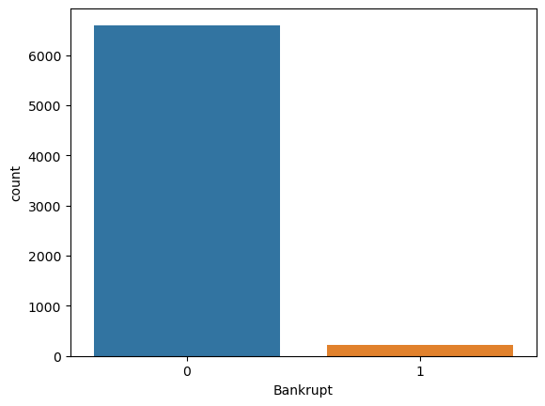
This chart is useful for visualizing the distribution of the 'Bankrupt' variable in our dataset. A count plot displays the number of occurrences of each category in the 'Bankrupt' column as bars, making it easy to identify the relative frequency of each category.
By examining the count plot, we can gain insights into the proportion of bankrupt and non-bankrupt firms in our dataset. This information can be useful in understanding the prevalence of bankruptcy and informing our approach to building a bankruptcy prediction model.

Slide 5
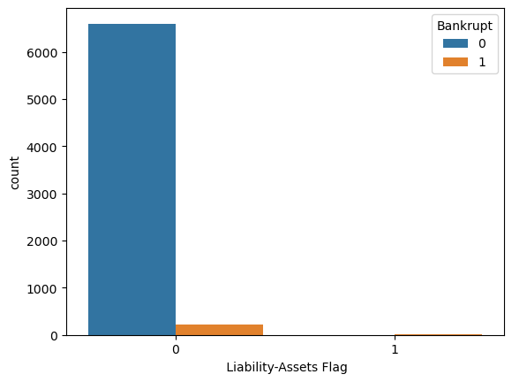
This count plot is useful for visualizing the relationship between the 'Liability-Assets Flag' variable and the 'Bankrupt' variable. By examining the count plot, we can determine the proportion of bankrupt and non-bankrupt firms for each category of the 'Liability-Assets Flag' variable.
This information can be used to identify any patterns or relationships between the variables, and to inform our approach to building a bankruptcy prediction model. For example, we may find that the proportion of bankrupt firms is higher for certain categories of the 'Liability-Assets Flag' variable, which could indicate a higher risk of bankruptcy for firms in those categories.

Slide 6
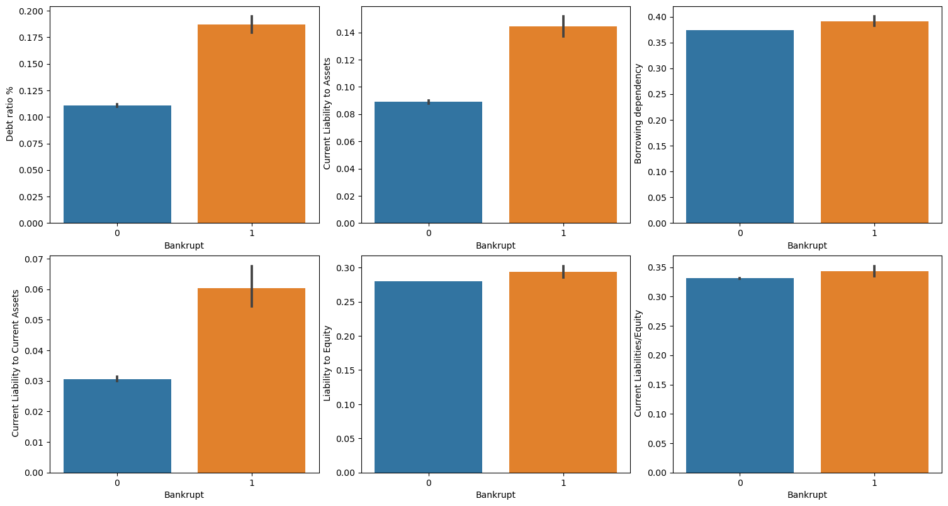
I have observed that three attributes, namely "Debt Ratio %," "Current Liability to Assets," and "Current Liability to Current Assets," tend to have higher values for bankrupt organizations. This implies that these attributes could be useful in identifying organizations that are at a higher risk of bankruptcy.

Slide 7
Algorithm that I used for prediction: Logistic regression:
Logistic regression is a commonly used statistical technique for modeling the relationship between a binary outcome variable (i.e., a variable that takes on one of two possible values, such as "bankrupt" or "non-bankrupt") and one or more predictor variables.
In the context of bankruptcy prediction, logistic regression can be used to build a predictive model that identifies the likelihood of a firm going bankrupt based on its financial and accounting data. The model estimates the probability of bankruptcy by fitting a logistic function to the data, which maps the predictor variables to the probability of bankruptcy.
There are several advantages to using logistic regression for bankruptcy prediction. For one, it is a relatively simple and interpretable model, which makes it easy to understand and communicate to stakeholders. Additionally, logistic regression is well-suited for binary classification tasks, such as identifying bankrupt versus non-bankrupt firms.

Slide 8
Data modeling step:
To prepare our data for modeling, we first separated the features in our dataset into categorical and numerical groups. Next, we used the feature selection library from scikit-learn to identify the top 40 features that were most important in predicting bankruptcy.
We then split our data into separate training and testing datasets using the model selection library of scikit-learn, with a test size of 0.3. This allowed us to train our logistic regression model on the training data, and evaluate its performance on the separate testing dataset.
Finally, we fit our training data to a logistic regression model, which allowed us to predict the likelihood of bankruptcy for each firm in our dataset based on its financial and accounting data.

Slide 9
Accuracy Score:
We obtained an impressive accuracy score of 97% on our bankruptcy prediction model. This means that our model was able to correctly predict bankruptcy status for 97% of the firms in our dataset based on their financial and accounting data. This high accuracy score indicates that our model is effective at identifying firms that are at risk of bankruptcy, and can provide valuable insights for creditors and investors evaluating potential investments.

Slide 10
Thank You

